Slide 1
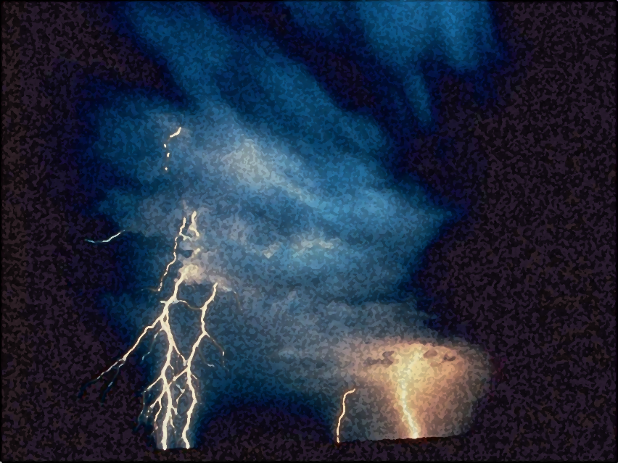

Light out of Darkness
The Vision of Isaiah
Doom to Bloom

Slide 2


The Vision of Isaiah
How to become a useful, faithful and righteous servant of God.
A Call to Servanthood
How does sinful Israel become servant Israel?

Slide 3
The Vision of Isaiah
“I have nourished and brought up children,
Notes:
The LORD had been a loving father to the nation. He cared for them. Even while they were wondering in the wilderness, they never lack anything.

Slide 4
The Vision of Isaiah
“I have nourished and brought up children, and they have rebelled against Me…” (1:2a)
Israel has forsaken the LORD and had fill their land with the ways of the nations and the land was full of idols.
Notes:
But a surprising and shocking development has occurred, God’s children, His people have rebelled and forsaken the LORD, and have follow the ways of man and have replaced the creator with the created; They now worship and serve what they have created; Essentially they worship and serve themselves.
Isaiah shows that there is a great folly in man exalting himself and abandoning God. Though humanity is full of the worldly knowledge, humanity is empty and void of truth. Though humanity attempts to lift himself and exalts himself up high, humanity is brought low. In the end mankind is reduced to hiding in caves when true greatness appears.

Slide 5

The Vision of Isaiah
Notes:
Without God man is a great big zero. In fact modern man has come to the same conclusion. Having rationalize God out of existence, rather than elevation humanity modern philosophies have contributed to dehumanization. “They have stripped human life of any significance by insisting that human life is meaningless and purposeless, the product of random events. Humans are merely a cosmic accident, a jumble of chemicals that came together by a stroke of dumb luck, actually a million dumb luck accidents called mutations… we are the result of millions of genetic copying mistakes. I guess that would make us a colossal mistake.

Slide 6
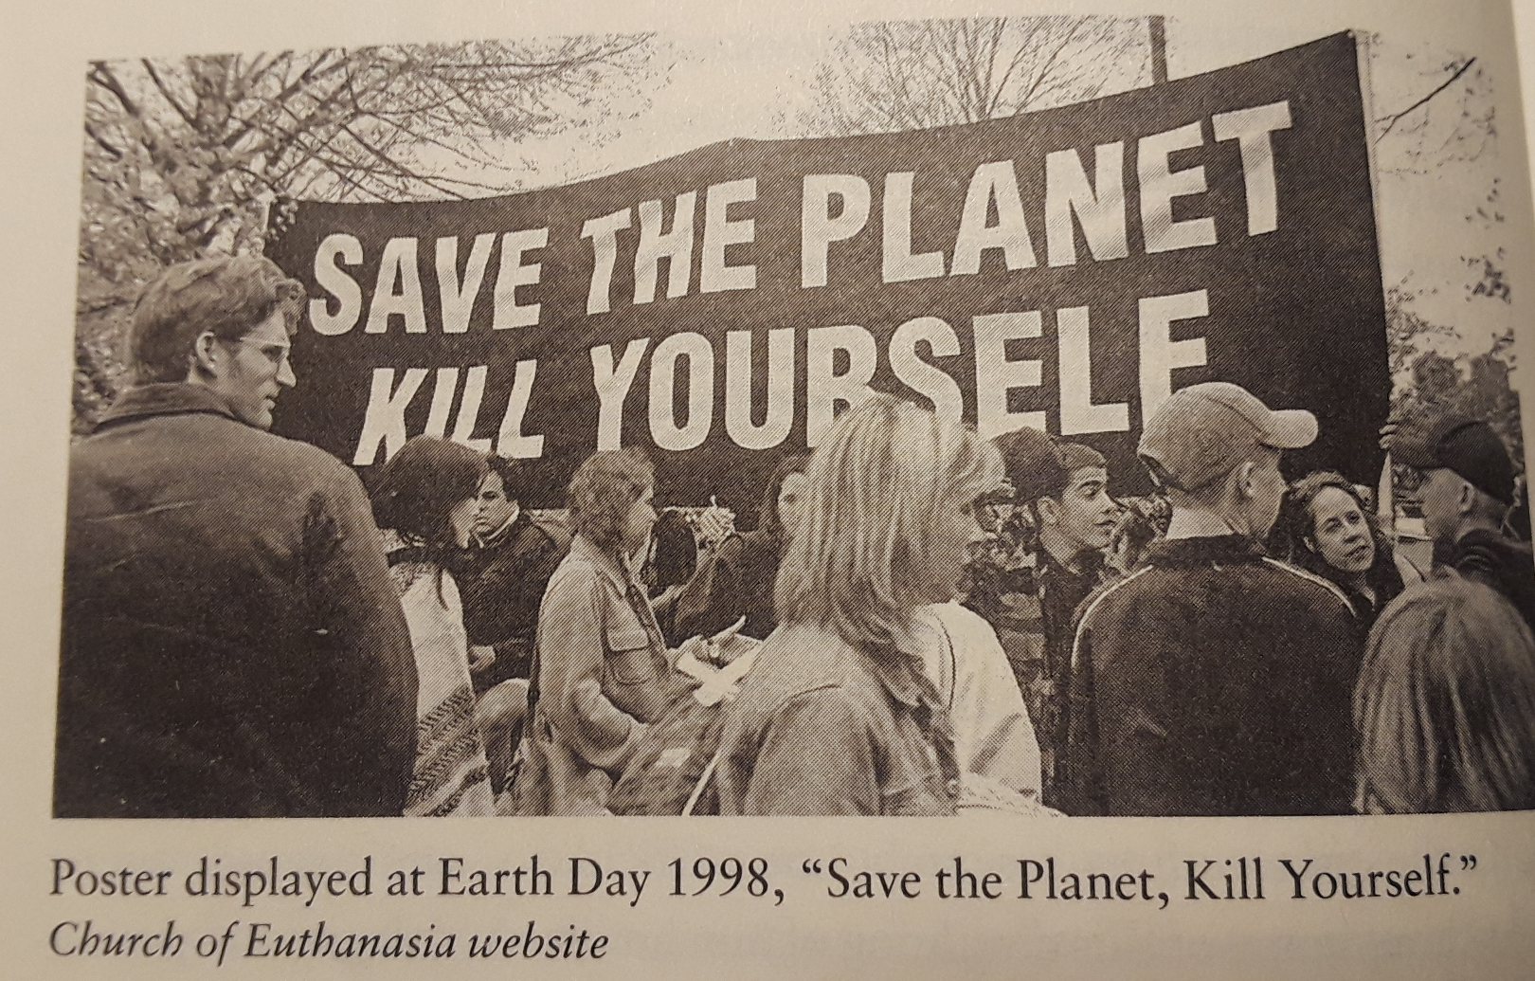
The Vision of Man
Notes:
Also the godless deny the existence of any fixed morality, undermining all human rights, including the right to life. The idea that humans are unique, special, sacred and have greater value than other organizes is antiquated, out of date. The modern view is that humans are not special and have no intrinsic value. When such ideas are being not in our schools, why then do they wonder why mass murders occur. It is a logical conclusion to such thinking. The more the merrier.
But they are also conflicted. On the one hand their existential philosophy teacher things just happen for no rhyme or reason and humans have no real value, on the other hand those who suffered the loss of their children and husbands saw them having great value to them. They are confused and have no answers outside of God. The solution is not getting rid of the tools of death, guns!
It is not so much the tools of death - guns, assault rifles, knifes, cars, trucks, planes, bombs etc. etc. that kill and murder, but it is the devaluation of human life is the reason people kill. And it is not so much the MEDIUM – movies, TV, video games, comic books (the reflection of modern thinking) that cause killers to kill, but it is the MESSAGE that humans are not important that kills.
One of the most prominent bioethicist is Peter Singer, who holds the chair in bioethics at Princeton University's Center for Human Values believes that human are have no real value above anything else. He believes that man’s destiny in extinction.

Slide 7
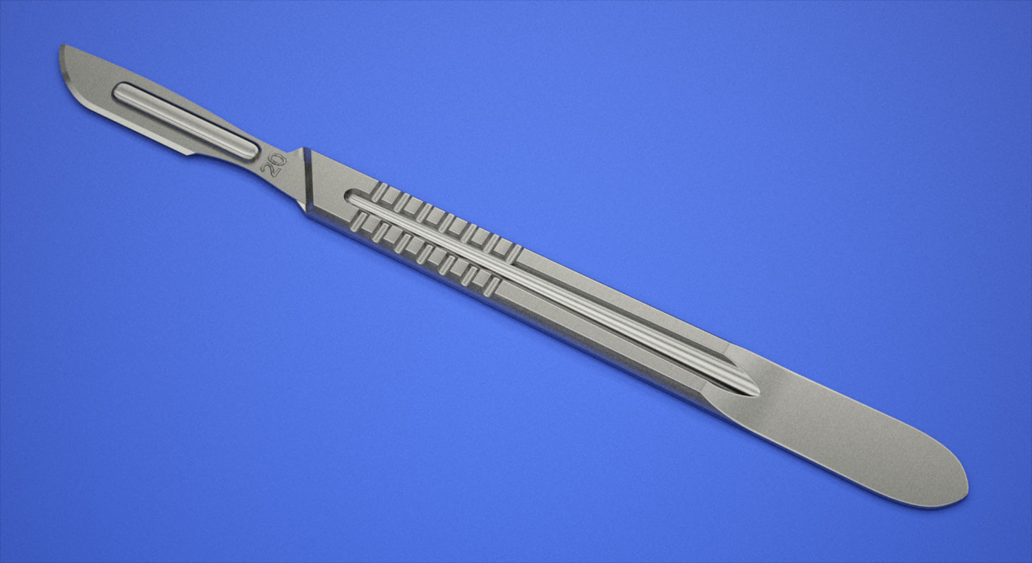
The Vision of Man
Notes:
{The #1 tool of mass murder is… the scalpel. Used to aborted, to kill, to murder, to commit mass murder into the millions, infants still in the womb of their mothers] Why? Because they have no value to our society, unplanned and unwanted.
One of the most prominent bioethicist is Peter Singer, who holds the chair in bioethics at Princeton University's Center for Human Values believes that human are have no real value above anything else.

Slide 8
The Answer
A Vision of the Lord, the Sovereign,
the LORD,
the Holy One!
Notes:
The answer is God, A vision of God, who is both “Adonai” the Lord, the Sovereign one and the “Yahweh” the LORD, the Holy One! who has the power and the grace to make man great again.

Slide 9
The Vision of Isaiah
Isaiah introduces the problem: proud, arrogant sinful Israel is anything but the servant of God (1-5). The answer is God (6), the God who has the power (7-39) and the grace (40-66) to make the impossible, possible.

Slide 10
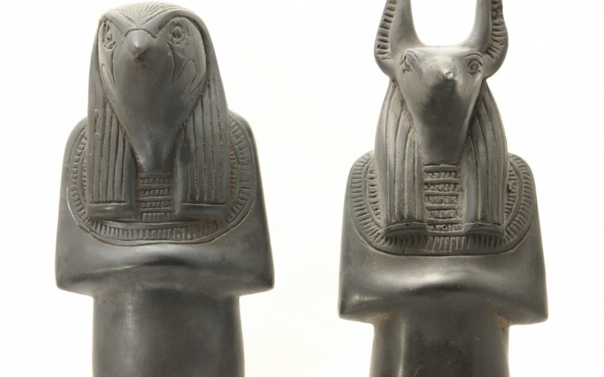
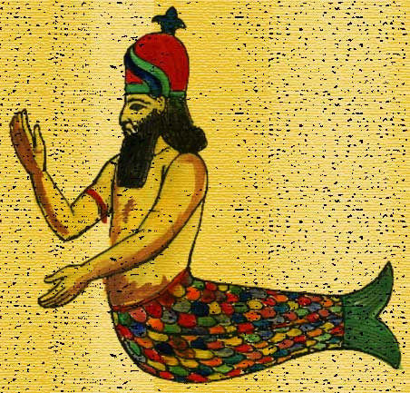
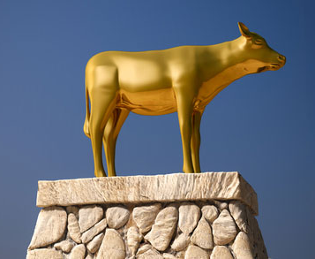
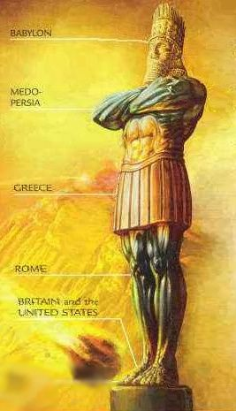
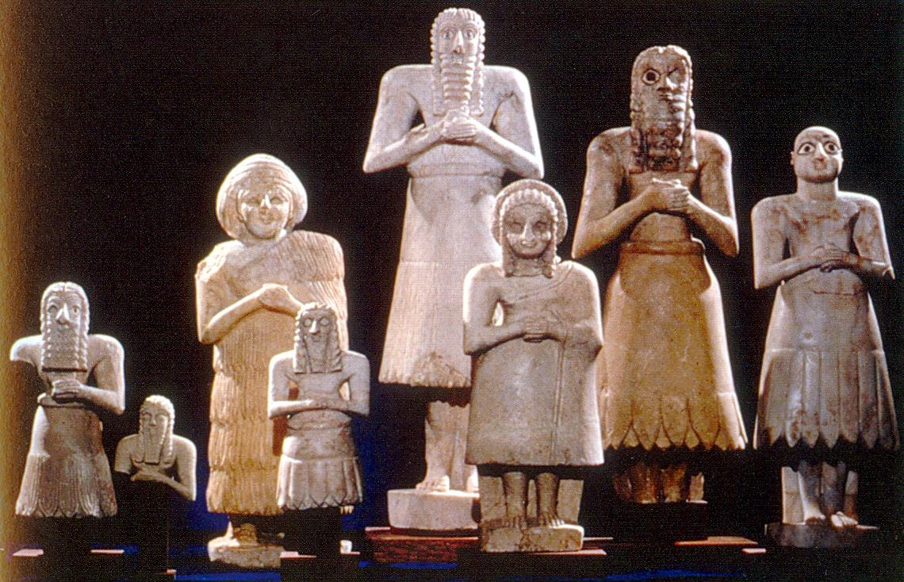
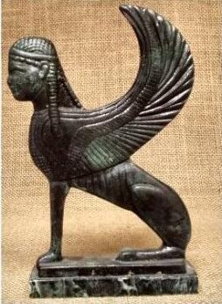
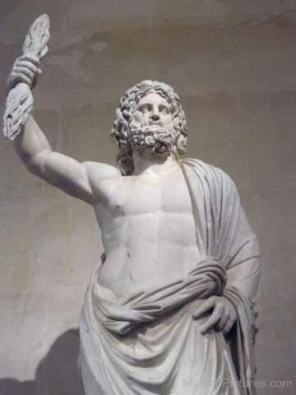
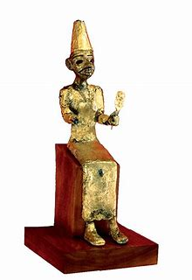
The Vision of Isaiah
Notes:
Instead of teaching the nations God’s ways, Israel was being taught the ways of the world. They were learning dependence on human greatness, exalting themselves exhibited in the idols they had made with their own hands.
But Isaiah shows in 2:6 – 4:1 by a series of stunning contrast how such dependence does not exalt, but humiliates. “Because the land is full of idols and they worship the work of their own hands.” (2:8) in a feeble attempt to exalt themselves above the LORD (2:11,17) The LORD will turn His hand against them and their country will be the left desolate, the land will become a wilderness, they will far by the sword, and those who remain will be removed to far away places. (1:25a, 1:7a, 27:10, 6:12)
True greatness cannot appear until God’s greatness is permitted to shine over all. Until this takes place, humanity’s potential is zero.

Slide 11
The Vision of Isaiah
Greed and Indulgence
Coming
Destruction
Debauchery
Dimwitted
Cynicism and Perversion
Injustice
Notes:
The current sinful condition of Israel as seen in chapter 5 was ripe for harvest. The verdict: God will remove his protection of the nation. The LORD will turn His hand against them and their country will be the left desolate, the land will become a wilderness, they will far by the sword, and those who remain will be removed to far away places (1:25a, 1:7a, 27:10, 6:12)

Slide 12
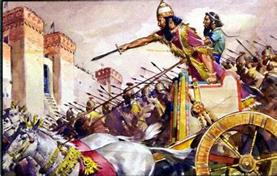
The Vision of Isaiah
Greed and Indulgence
Coming
Destruction
Debauchery
Dimwitted
Cynicism and Perversion
Injustice
Notes:
That destruction will come by the form of an invading army. Only a stump will remain, a small remnant will return.

Slide 13
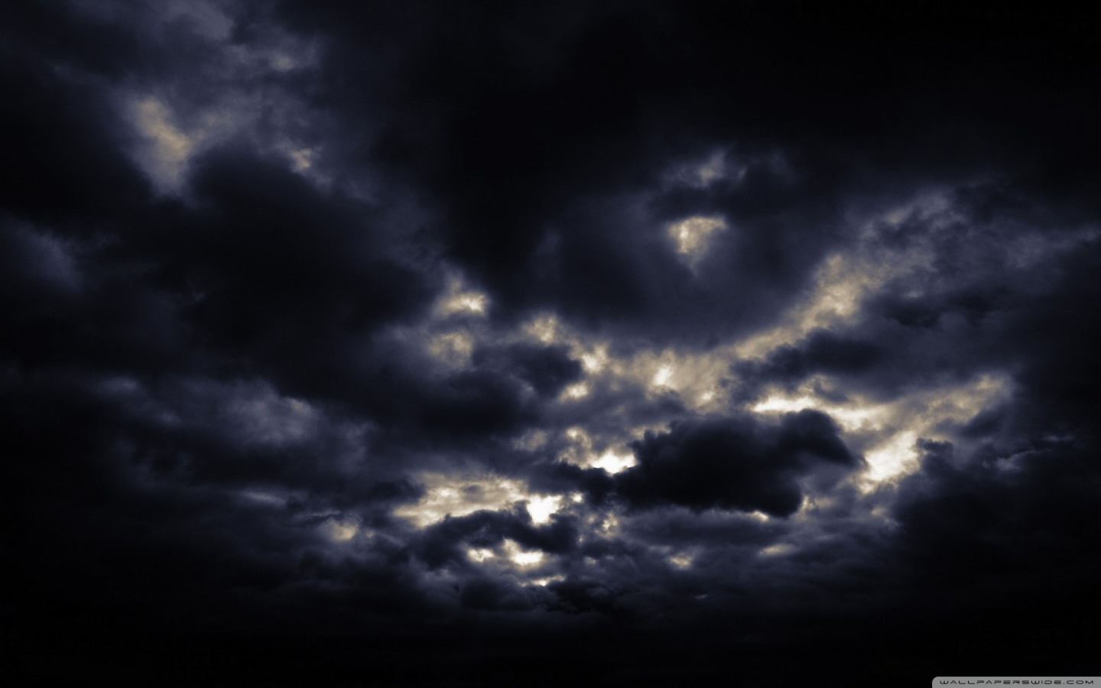
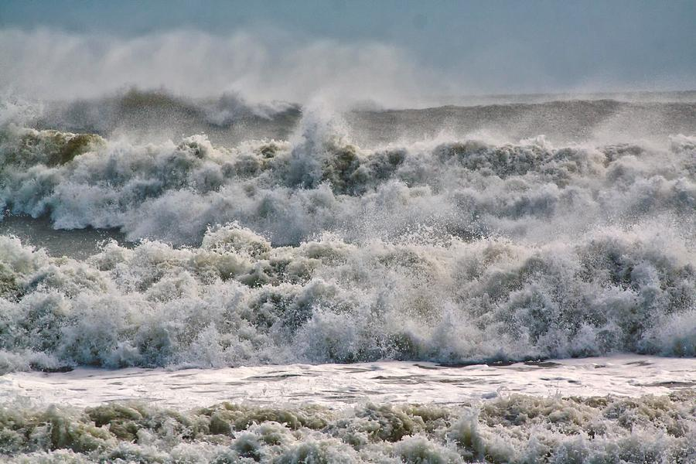
Wild Grapes
“In that day they will roar against them like the roaring of the sea. And if one looks to the land, Behold, darkness and sorrow; And the light is darkened by the clouds.” (5:30)
Notes:
“Behold, darkness and sorrow; And the light is darkened by the clouds.” (5:30b) Hope is gone, darkness and distress fill the land, the light of day is even obscured by the dark clouds of battle.

Slide 14
The Vision of Isaiah
The LORD is Reasonable
“Come now, and let us reason together,… Though your sins are like scarlet, they shall be as white as snow… ‘If you are willing and obedient, You shall eat the good of the land; But if you refuse and rebel, You shall be devoured by the sword“. (1:18-20)

Slide 15
The Vision of Isaiah
The LORD is Merciful
“For a mere moment I have forsaken you, but with great mercies I will gather you.” (54:7)
The Forsaking is Temporary

Slide 16
The Vision of Isaiah
Israel Restored
4:2-6
“what will be”
“the Branch of the LORD will be beautiful and glorious”
Notes:
Israel will be made great again.

Slide 17
The Vision of Isaiah
Notes:
Out of darkness come a great light. A vision of the LORD given to Isaiah God’s servant.

Slide 18

The Vision of Isaiah
Broad Issues, Behaviors and Consequences
1-5
The
Call
6
Specific
“Trust”
7-12
Notes:
“Chapter 6 functions like a hinge, containing as it does the words of utter doom and yet the example of the prophets own cleansing and the concluding note of hope.” Chapter 6 has a double function. It acts as an conclusion to the chapters before and an introduction to the chapters that follow.
Chapters 1-5 deal with broad issues, behaviors and their consequences. Chapters 7-12 are predominately specific, the issue of “Trust”. They deal with a particular historic occasion and the implication of that occasion in both the near and the distant perspectives. They deal with a very specific theological problem: why trust? Chapter 12 is a climax to 7-12.
It does not deal with the issues of 1-5, pride, pretense and the worship of human potential. Nor does it deal with the need for repentance, cleansing, and ethical obedience. Rather, the focus is upon God’s trustworthiness and his capacity to save those who will trust him.” (Oswalt, p. 173)
There is a theological connection between a condemnation of trust in the nations (humanity) a promise of deliverance from the nations (7-12), and an announcement of doom upon the nations (13-23). (p. 174)

Slide 19
The Vision of Isaiah
Sinful to Servant
1-5
Gracious Provision for Sin
6
Speaking for God
7-12
Notes:
Two forms are involved here: a call form and judgment form. The account combines two kinds of experiences, so it functions in two ways in its context. Chapters 1-5 have raised a serious problem. Sinful, arrogant Israel is going to be the holy people of God to whom the nations will come to learn of God.
How can this be? Ch. 6 provides the solution. Sinful Israel can become servant Israel when the experience of Isaiah becomes the experience of the nation. When the nation has received God’s gracious provision for sin, then she can speak for God to a hungry world. What is available for Isaiah can be available for all, the whole nation. Isaiah identifies with the nation, both are unclean, both are in need of cleansing of sin, and their will be a time when Isaiah’s experience will be duplicated on a national scale (but not yet), the nation must first learn to trust the LORD.
Chs. 7-12 are a fulfillment and an explanation of the word given to Isaiah in his call. You immediately see the hardening impact of the prophet’s gracious invitation to trust. In a real sense the destruction that comes to Judah from Assyria’s hand in the declining years of the eight century is caused by King Ahaz’s refusal of Isaiah invitation to trust in the LORD. Thus the nation is cut down like a field of stumps. Yet, in one of those stumps life remains so that the nation might learn that God can be trusted. (p. 175).
Chapter 6 a genuinely strategic chapter, shaping and defining the book as a whole. Ch. 6 functions with both sections, both showing the way of the future (1-5) and explaining the present situation (7-12).

Slide 20
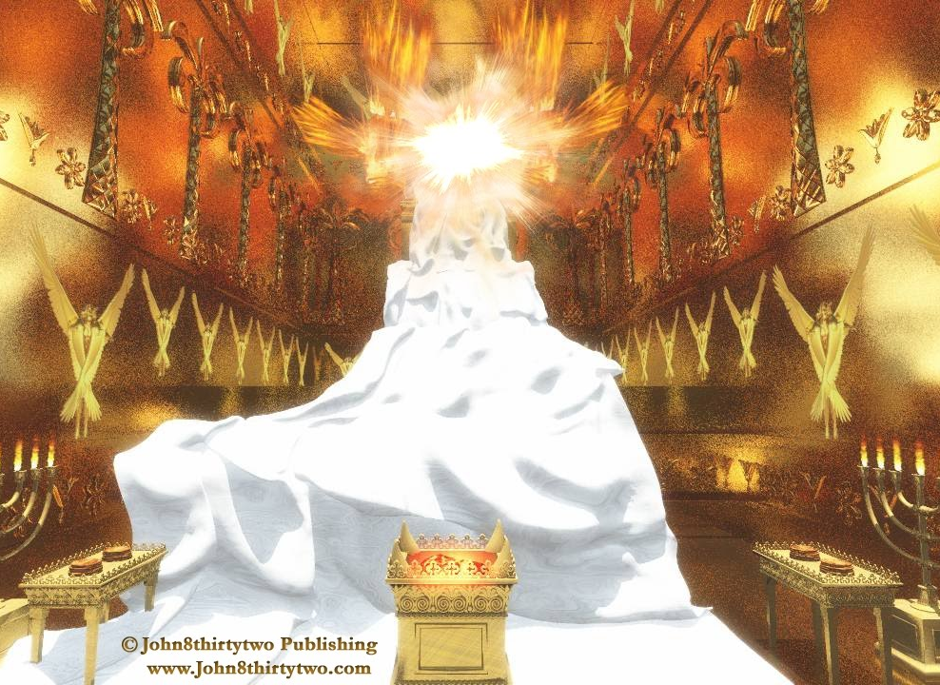
The Vision of Isaiah
Notes:
The vision reported by Isaiah is fundamental to the entire course of his ministry and to the shape of the entire book. The glory, majesty, the holiness, and the righteousness of God became the ruling concepts. And it explains his contempt for, and horror of, any kind of national or individual life which did not pay adequate attention to the one God.

Slide 21
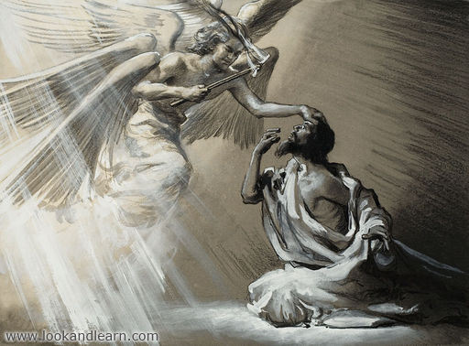
The Vision of Isaiah
A Call to Servanthood
6:1-13

Slide 22
Call to Servanthood
The Vision of the Lord
6:1-7

Slide 23
Call to Servanthood
“In the year that King Uzziah died, I saw the Lord sitting on a throne, high and lifted up, and the train of His robe filled the temple.” (6:1)
Notes:
Judah had known no king like Uzziah since the time of Solomon. He was an efficient administrator and able military leader. He made war with mighty power and defeated the Philistines, the Arabians and others. He fortified the cities. Judah had grown in every way and God made him prosper and wealthy. He had been a true king.

Slide 24
Call to Servanthood
“In the year that King Uzziah died, I saw the Lord sitting on a throne, high and lifted up, and the train of His robe filled the temple.” (6:1)
Notes:
But now Uzziah was dead. And in that year Isaiah saw the real Sovereign, “Lord” – Adonai. The deity he sees is the absolute overlord of the earth.
The Hebrews usually believed that anyone who saw God would die, it was also true that various individuals were permitted to see Him. [No one actually sees God, who is invisible. But HE makes Himself visible “a manifestation” by taking on visible form, usually in the form of a fiery brilliant light, a burning bush, and He takes on a human form.]

Slide 25
Call to Servanthood
“In the year that King Uzziah died, I saw the Lord sitting on a throne, high and lifted up, and the train of His robe filled the temple.” (6:1)
Notes:
The veil was apparently removed and there, where the ark ought to be was a great throne. The absolute sovereign of God is stressed. He alone is King. The whole quality of Isaiah’s experience is one of awe and fear. And the throne is in His big house, God’s palace.

Slide 26
Call to Servanthood
“In the year that King Uzziah died, I saw the Lord sitting on a throne, high and lifted up, and the train of His robe filled the temple.” (6:1)
Notes:
God was lifted up, exalted by means of a throne. “The emphasis upon God’s exaltation is entirely in keeping with the themes of the book. Human attempts at self-exaltation are the height of folly. Only God is exalted. Only when we are humble shall we be exalted.” (p. 178)

Slide 27
Call to Servanthood
“In the year that King Uzziah died, I saw the Lord sitting on a throne, high and lifted up, and the train of His robe filled the temple.” (6:1)
Notes:
The description of God’s appearance can rise no higher than edge of His robe. The robe itself did not fill the temple, but the presence and the greatness of God filled the temple.

Slide 28
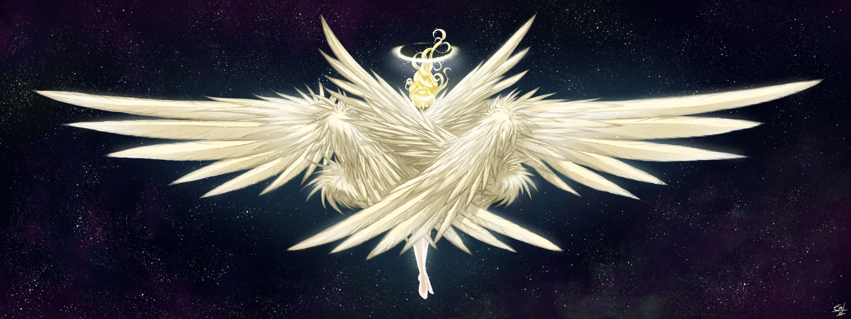
Call to Servanthood
“Above it stood seraphim; each one had six wings: with two he covered his face, with two he covered his feet, and with two he flew.” (6:2)
Notes:
Seraphim similar to “serpents” only in that snakes have fiery bite. They were “fiery one”. And fire is everywhere associated with the holiness of God, and it is entirely appropriate for those who declare the holiness of God to be “fiery” in their appearance. They are all wings and voice perfectly suited and ready for praise and service.

Slide 29
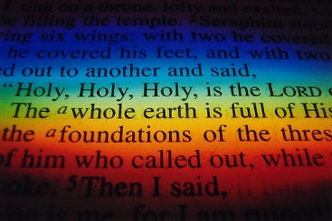
Call to Servanthood
“And one cried to another and said: ‘Holy, holy, holy is the LORD of hosts; the whole earth is full of His glory!” (6:3)
Notes:
The Seraphim were delighting with one another in the glory of God.
The common title for God in Isaiah is “the Holy One of Israel” occurring 26x’s and only 6x’s elsewhere. This experience convinces Isaiah that God is Holy. But what does holy mean? Holiness is distinctness, a uniqueness, divinity that is set apart from all other things. Holiness is the essential expression of what made God to be God, it includes divine characteristics that apply only to God, but primarily his ethical behavior like justice and righteousness. “Here is One ethically pure, absolutely upright, utterly true.” (p. 181)
He is thrice holy, the holiest of all. He is the Holy One. The most “godly” of all the gods. He alone deserves to be called holy.
The entire nation of Israel was to be a holy to God, and they will manifest that special relationship through a particular type of ethical behavior. In Leviticus the LORD called them “to be holy as I am holy”.

Slide 30
Call to Servanthood
“And one cried to another and said: ‘Holy, holy, holy is the LORD of hosts; the whole earth is full of His glory!” (6:3)
Notes:
The whole earth is full of His Glory indicates that His presence is not restricted to the temple.
“Thus, where God’s glory is manifested, there is judgment for sin, for the two cannot exist side by side.”

Slide 31
Call to Servanthood
“And the posts of the door were shaken by the voice of him who cried out, and the house was filled with smoke.” (6:4)
Notes:
There voices was like thunder that shook and rocked the very foundation of the building.

Slide 32
Call to Servanthood
“So I said:.. ‘Woe is me, for I am undone! Because I am a man of unclean lips, and I dwell in the midst of a people of unclean lips; For my eyes have seen the King, the LORD of hosts.” (6:5)
Notes:
At this point, Isaiah becomes aware of himself, aware that he is unholy in the presence of the Holy One. He who had be pronouncing “woe” upon others now must pronounce “woe” on himself. This confrontation cannot help but produce a sense of despair. “For the finite, the mortal, the incomplete, and the fallible to encounter the Infinite, the Eternal, the Self-consistent, and the Infallible is to know the futility and hopelessness of one’s existence.” (p. 182).
“undone” – “ruined” – “destroyed” – It is not Isaiah’s finiteness that crushes him, but his uncleanness, un-holiness.

Slide 33
Call to Servanthood
“So I said:.. ‘Woe is me, for I am undone! Because I am a man of unclean lips, and I dwell in the midst of a people of unclean lips; For my eyes have seen the King, the LORD of hosts.” (6:5)
Notes:
Why are his lips unclean? – The lips are an expression, the heart and the will, do not belong to God. If Isaiah and his people are ever to serve God with clean lips then sin must be removed.

Slide 34
Call to Servanthood
“So I said:.. ‘Woe is me, for I am undone! Because I am a man of unclean lips, and I dwell in the midst of a people of unclean lips; For my eyes have seen the King, the LORD of hosts.” (6:5)
Notes:
The prophet recognizes that the fate of the nation, as well as his own fate, does not finally rest in the hand of any human king, but the king of creation.
In the year that king Uzziah the lesser king, was removed, that the greater King could be seen.
“the LORD of host is the LORD of Judgment, which magnified his sense of ruin.

Slide 35
Call to Servanthood
“Then one of the seraphim flew to me, having in his hand a live coal which he had taken with the tongs from the altar.” (6:6)
Notes:
This verse speaks to the depth of God’s grace. Isaiah does not plead for mercy, or make great promises of commitment if God will deliver him. No promise of repentance. He is in a state of hopelessness. After a confession of his sinful state, only then does the “fiery one” come with a purifying fiery hot coal. The coal was a charred portion of the whole burnt offering that came from the altar in which a blood sacrifice for the atonement of sin was made.
“Fire is an appropriate image of God’s holiness. Fire can be a source of great blessing, but is not easily controllable. Fire can destroy, but also cleanse. Fire is fascination but also slightly terrifying. Fire translates mass into energy. So is the holiness of God.” (p. 184) “Our God is a consuming fire” (Heb. 12:29) a fire of righteousness in which unrighteousness is devoured.

Slide 36
Call to Servanthood
“And he touched my mouth with it, and said: ‘Behold, this has touched your lips; Your iniquity is taken away, and your sin purged.” (6:7)
Notes:
The fiery coal from the fiery one touches the prophet’s mouth. Isaiah does not seek purification at all. It is given to him, as a free gift.
But what causes sin and iniquity? It is the arrogant, self-sufficiency, human exaltation which refuses to acknowledge God’s exalted position. This is the ultimate uncleanness of which Isaiah has been accusing his people and now finds present in himself. Only when humanity surrenders to divine surgery that the it can become clean.

Slide 37
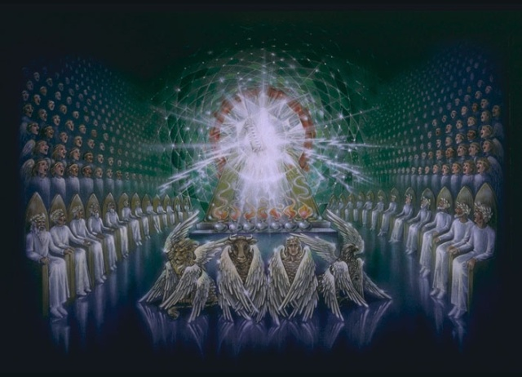
Call to Servanthood
The Call of the Lord
6:8

Slide 38
Call to Servanthood
“Also I heard the voice of the Lord, saying: ‘Whom shall I send, and who will go for Us?’ Then I said, ‘Here am I! Send me.” (6:8)
Notes:
Now for the first time, God speaks. The experience (of initial salvation) is not an end in itself. It leads to a call of servanthood.
Isaiah does not need to be coerced, but rather needs an opportunity to volunteer.
Read page 186

Slide 39
Call to Servanthood
“The kings death prepares the way for the vision of God; the vision of God leads to self-despair; Self despair opens the door to cleansing; cleansing makes it possible to recognize the possibility of service; the total experience then leads to an offering of oneself.” (Oswalt, p. 186)

Slide 40
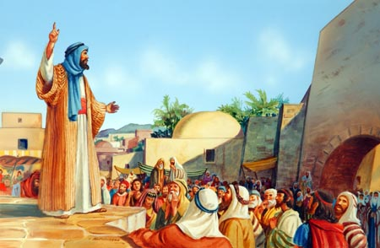
Call to Servanthood
The Commission
6:9-13
Notes:
“Almost all sermons on Isaiah 6 concludes with verse 8. Probably because of the frankly disturbing character of the remaining chapter… especially disturbing to Christians whose whole upbringing has conditioned them toward an emphasis upon God’s forgiving grace and will to deliver. Yet these verse depict God as preventing repentance (faith) so that total destruction may occur (for that generation). God favors faith and reject unbelief. If Isaiah’s generation and those who later read his book refuses to believe and repent then unavoidable doom will come upon them. Only a glimmer of hope appears at the end.
These words do not sum up the content of Isaiah preaching – he could still preach healing and hope – but the effect of his preaching would be hardening and destruction.

Slide 41
Call to Servanthood
“And He said, "Go, and tell this people: 'Keep on hearing, but do not understand; Keep on seeing, but do not perceive.” (6:9)
Notes:
Not “my” people, but “this” people, expresses divine displeasure.
Hearing, but not understanding – a strange contradiction.
“…the disease of pride and rebellion has gone so deeply that they will simple misperceive the truth of what they here.” “…always learning and never able to come to the knowledge of the truth.” (2 Tim 3:7)

Slide 42
Call to Servanthood
“Make the heart of this people dull, and their ears heavy, and shut their eyes; Lest they see with their eyes, and hear with their ears, and understand with their heart, and return and be healed.” (6:10)
Notes:
Isaiah’s preaching will not make it easier for the people to believe and repent. It will make it more difficult. Why should God desire to harden their hearts? The text itself gives no reason. It is evident that there is something more important than healing [salvation] here. What could that be – The pure revelation of the character of God and the human condition.
God had already adequately reveal himself to them. Because the people were already apathetic his preaching will make them even more apathetic. They had forsaken, rebelled and abandon God, therefore God was forsaking them. Further revelation could only harden Isaiah’s generation in even further, confirming them in their rebellion. Harden unbelief always demands more revelation. But more revelation only hardens them even more.
Jesus adequately revealed to the generation of Jews in His day multiply signs that He was the Messiah, but yet they demanded even more signs. Jesus said I will give you no more signs, except the sign of the resurrection. They rejected that sign as well and Rome later came and destroyed them. In the Great Tribulation God will once again preach a message of repentance, they will refuse and Antichrist will destroy them.
I know, “Lets send someone from the dead and then they will repent. The rich man suggested sending Lazarus from the dead to his brothers. “Abraham said, ‘They have Moses and the prophets, let them here them”. (Luke 16:29). “If only Jesus would physically appear here now before me, then I will believe and follow Him! NOT! People ask, “Where is the evidence of God’s existence?” It’s everywhere, plainly seen in the things He has made.
May be Isaiah could alter the truth, soften it up a bit, make it more acceptable, easier to swallow [like some do today] It might create bigger crowds and bigger churches. “Let’s give them the gospel of good advise.” It would however not result in true revival, but fake revival and fake churches. Nothing can heal and save except God’s truth.
“It is as though Isaiah should tell them that they did not need to see God as he did, nor be cleansed as he was, to be a servant of God, as he was. The ultimate result would be deadly. It would confirm that generation and pervert the truth for all generations to come. It would sell the future for the sake of the present. But if the truth could not save the present generation, if it would, in fact, destroy that generation, it could, faithfully recorded save future generations.” (p. 189)
“This then, was Isaiah commission, as it is of all servants of God, not to be successful in a merely human sense, but to be faithful to the message.” (p. 190)

Slide 43
Call to Servanthood
“Then I said, ‘Lord, how long?’ And He answered: ‘Until the cities are laid waste and without inhabitant, the houses are without a man, the land is utterly desolate, the LORD has removed men far away, and the forsaken places are many in the midst of the land.” (6:12)
Notes:
How long will I preach this message of doom? [Not a universal message. It is a message to that generation.] Isaiah is expressing a sense of sorrow and an implied request for mercy upon God’s people. It is a cry of dismay. When can he cease preaching judgment and turn to preaching salvation?
The answer is not comforting. There would be no reprieve for Judah. God’s justice will be carried out to its full extent until the land is empty (Deut. 28:21; 63; 29:28). Their land was not theirs to posses as their own. Rather, they possessed it in trust from the true landowner, God. So long as they remained in God’s favor, by living lives in keeping with his character, then the land was their to develop and to enjoy. But if they ceased to live in obedience to God, the land would vomit them out as it had the Canaanites before them.
All of this would be done by the Lord. Judah’s destruction would not be at the had of nations whose gods were too strong for Yahweh… The coming destruction had to do with Yahweh and His people, nothing more.

Slide 44
Call to Servanthood
“But yet a tenth will be in it, and will return and be for consuming, as a terebinth tree or as an oak, whose stump remains when it is cut down. So the holy seed shall be its stump.” (6:13)
Notes:
Yes, the desolation will be complete and completed. The nation will be like a forest cut down to their stumps, even the stumps will be burned. Yet even from a burned stump a shoot shall appear, bursting forth from the ashes. Utter desolation to be sure, but that desolation is not the end. There will be offspring holy to the Lord, for the Lord is not finished with Israel and Judah. God’s promise to Abraham to bless the nations through his offspring Is not to be forgotten. (p. 190)

Slide 45
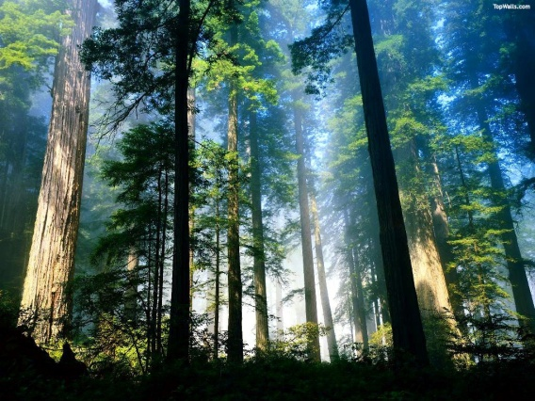
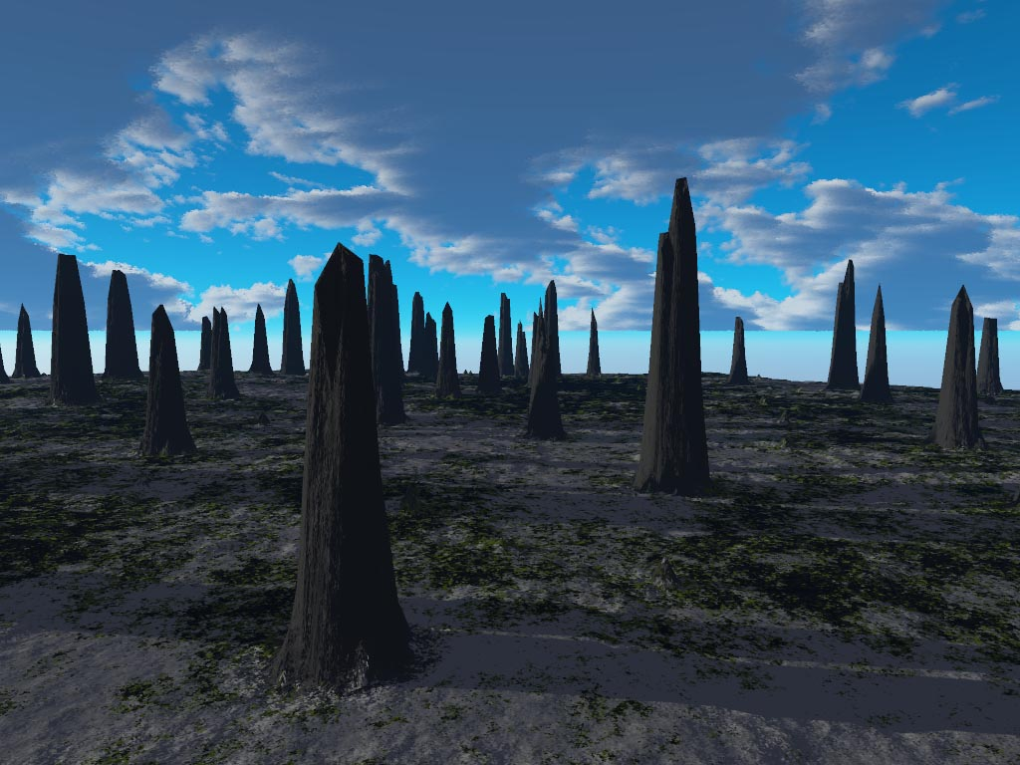

Slide 47
Conclusion
Notes:
There is much judgment, but it ends with a hopeful note… in God’s overall purposes judgment is never the last word. This is consistent with the present structure of chs. 7-12 as well as with the rest of the book as a whole. So hang on to your seats. There are only 60 more chapters to go.

Slide 48
The Vision of Isaiah
Notes:
Out of darkness come a great light. A vision of the LORD given to Isaiah God’s servant.

